Slide 1
Online Learning of a Noisy Teacher
Tutorial 8 Solution

Slide 2
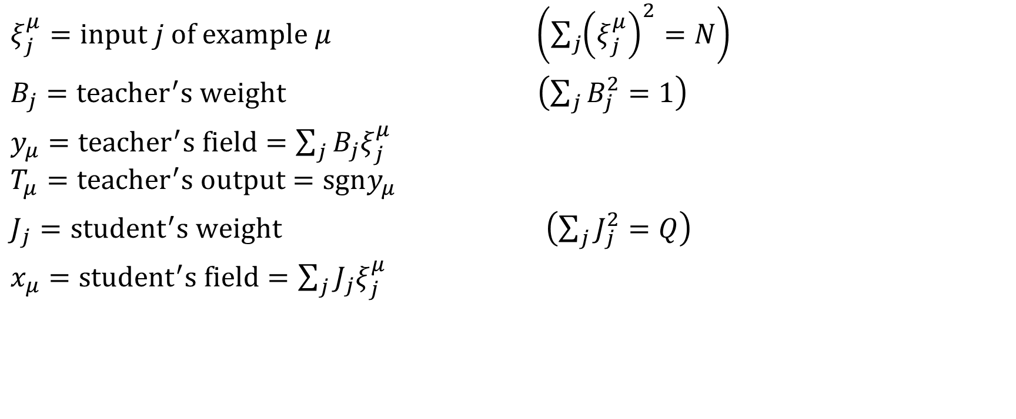
Notations (slides 28-29)
$ξ_{j}^{μ}=input j of example μ \left(\sum_{j}{{\left(ξ_{j}^{μ}\right)}^{2}=N}\right)$
$B_{j}={teacher}^{′}s weight \left(\sum_{j}{B_{j}^{2}}=1\right)$
$y_{μ}={teacher}^{′}s field=\sum_{j}{B_{j}ξ_{j}^{μ}}$
$$T_{μ}={teacher}^{′}s output=sgny_{μ}$$
$J_{j}={student}^{′}s weight \left(\sum_{j}{J_{j}^{2}}=Q\right)$
$x_{μ}={student}^{′}s field=\sum_{j}{J_{j}ξ_{j}^{μ}}$

Slide 3
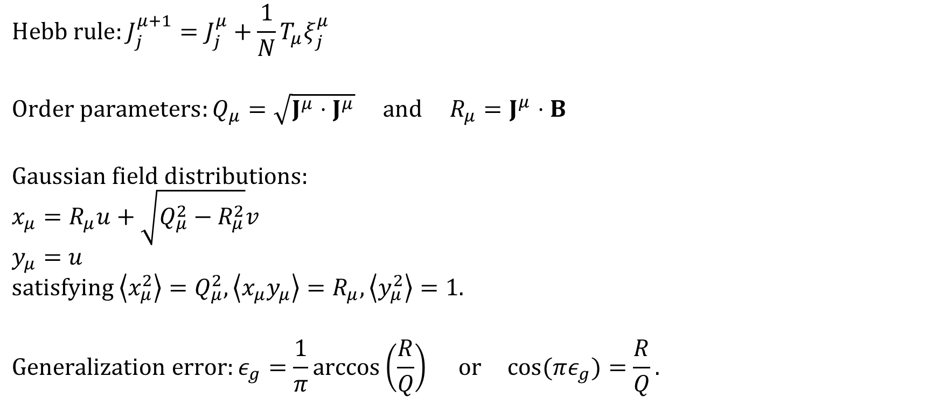
Review (slides 29-30, 33-34, 36-37)
$$Hebb rule:J_{j}^{μ+1}=J_{j}^{μ}+\frac{1}{N}T_{μ}ξ_{j}^{μ}$$
$$Order parameters:Q_{μ}=\sqrt{J^{μ}⋅J^{μ}} and R_{μ}=J^{μ}⋅B$$
$$Gaussian field distributions:$$
$$x_{μ}=R_{μ}u+\sqrt{Q_{μ}^{2}−R_{μ}^{2}}v$$
$$y_{μ}=u$$
$$satisfying \left\langle x_{μ}^{2}\right\rangle =Q_{μ}^{2}, \left\langle x_{μ}y_{μ}\right\rangle =R_{μ}, \left\langle y_{μ}^{2}\right\rangle =1.$$
$$Generalization error:ε_{g}=\frac{1}{π}\arccos\left(\frac{R}{Q}\right) or \cos{(πε_{g})}=\frac{R}{Q}.$$

Slide 4
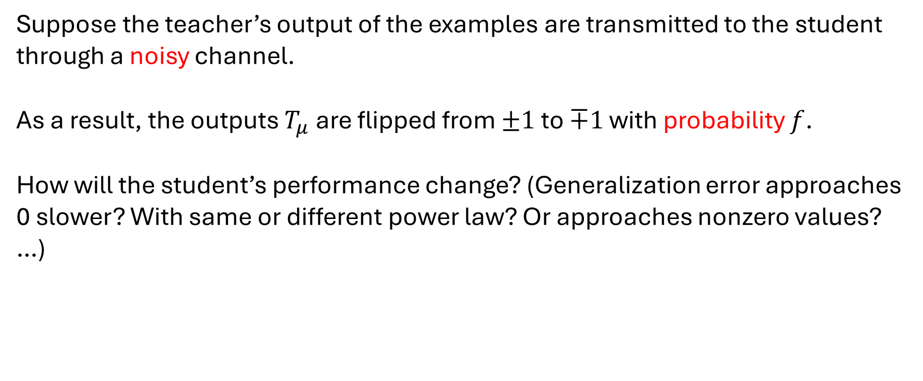
Noisy Teacher
Suppose the teacher’s output of the examples are transmitted to the student through a noisy channel.
As a result, the outputs $T_{μ}$ are flipped from $±1$ to $∓1$ with probability $f$.
How will the student’s performance change? (Generalization error approaches 0 slower? With same or different power law? Or approaches nonzero values? …)

Slide 5
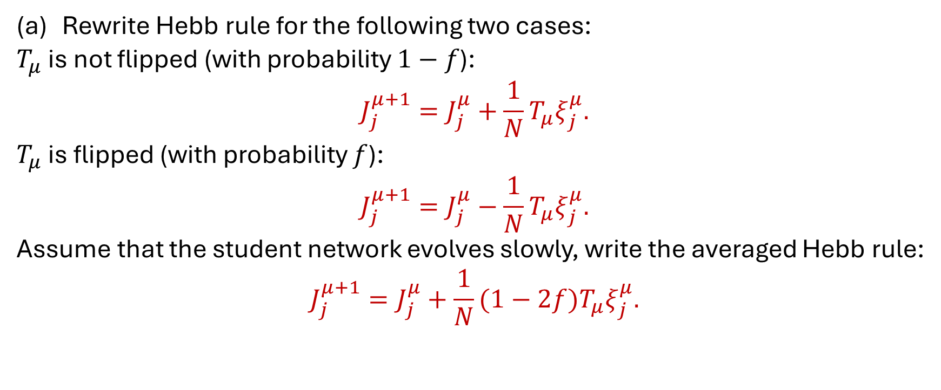
Noisy Hebb Rule
Rewrite Hebb rule for the following two cases:
$T_{μ}$ is not flipped (with probability $1−f$):
$$J_{j}^{μ+1}=J_{j}^{μ}+\frac{1}{N}T_{μ}ξ_{j}^{μ}.$$
$T_{μ}$ is flipped (with probability $f$):
$$J_{j}^{μ+1}=J_{j}^{μ}−\frac{1}{N}T_{μ}ξ_{j}^{μ}.$$
Assume that the student network evolves slowly, write the averaged Hebb rule:
$$J_{j}^{μ+1}=J_{j}^{μ}+\frac{1}{N}(1−2f)T_{μ}ξ_{j}^{μ}.$$

Slide 6
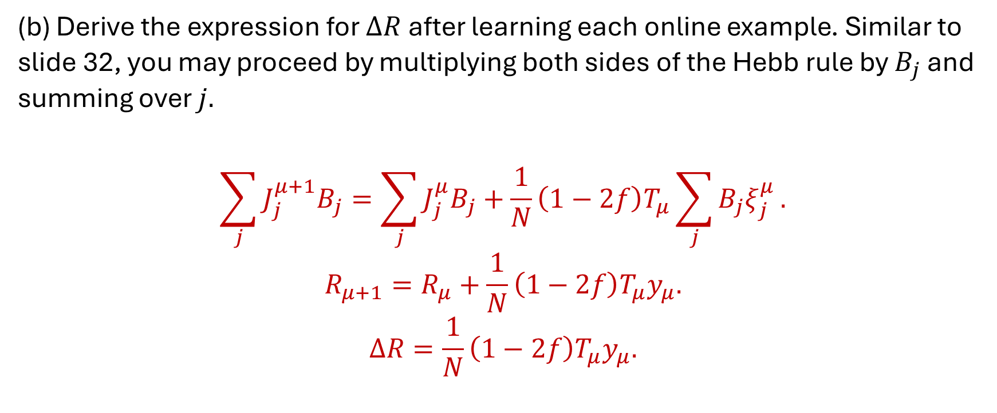
Noisy Student-Teacher Overlap
(b) Derive the expression for $ΔR$ after learning each online example. Similar to slide 32, you may proceed by multiplying both sides of the Hebb rule by $B_{j}$ and summing over $j.$
$$\sum_{j}{J_{j}^{μ+1}B_{j}}=\sum_{j}{J_{j}^{μ}B_{j}}+\frac{1}{N}\left(1−2f\right)T_{μ}\sum_{j}{B_{j}ξ_{j}^{μ}}.$$
$$R_{μ+1}=R_{μ}+\frac{1}{N}\left(1−2f\right)T_{μ}y_{μ}.$$
$$ΔR=\frac{1}{N}\left(1−2f\right)T_{μ}y_{μ}.$$

Slide 7
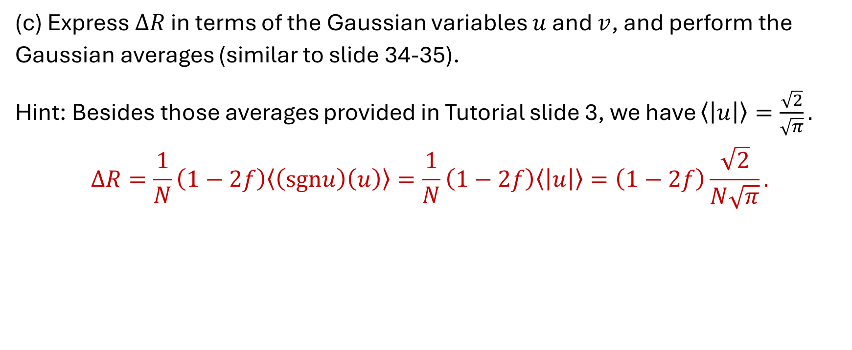
Gaussian Averages Are Convenient
(c) Express $ΔR$ in terms of the Gaussian variables $u$ and $v$, and perform the Gaussian averages (similar to slide 34-35).
Hint: Besides those averages provided in Tutorial slide 3, we have $\left\langle \left|u\right|\right\rangle =\frac{\sqrt{2}}{\sqrt{π}}.$
$$ΔR=\frac{1}{N}\left(1−2f\right)\left\langle \left(sgnu\right)\left(u\right)\right\rangle =\frac{1}{N}\left(1−2f\right)\left\langle \left|u\right|\right\rangle =\left(1−2f\right)\frac{\sqrt{2}}{N\sqrt{π}}.$$

Slide 8
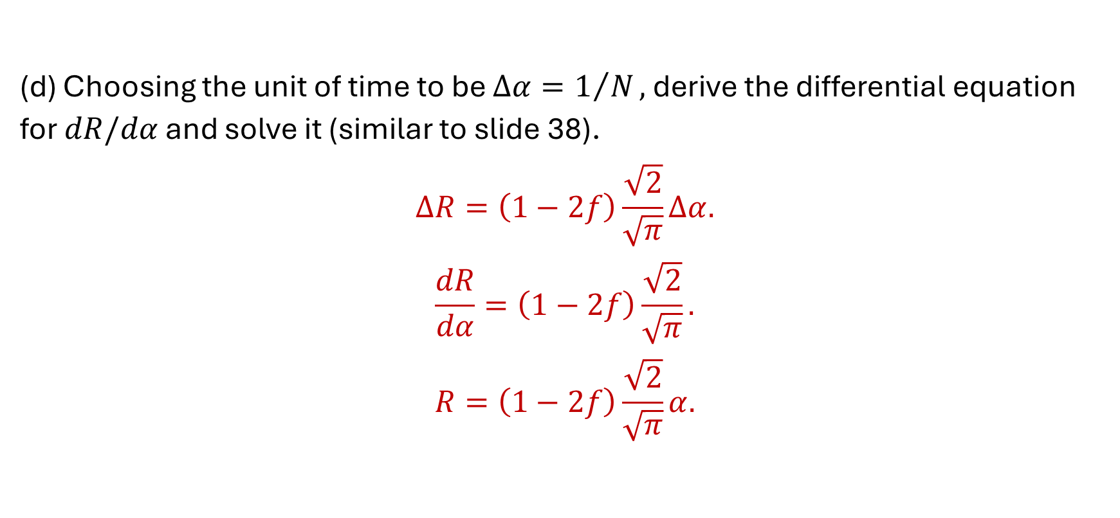
Nonlinear Dynamical Equation
(d) Choosing the unit of time to be $Δα=1/N,$derive the differential equation for $dR/dα$ and solve it (similar to slide 38).
$$ΔR=\left(1−2f\right)\frac{\sqrt{2}}{\sqrt{π}}Δα.$$
$$\frac{dR}{dα}=\left(1−2f\right)\frac{\sqrt{2}}{\sqrt{π}}.$$
$$R=\left(1−2f\right)\frac{\sqrt{2}}{\sqrt{π}}α.$$

Slide 9
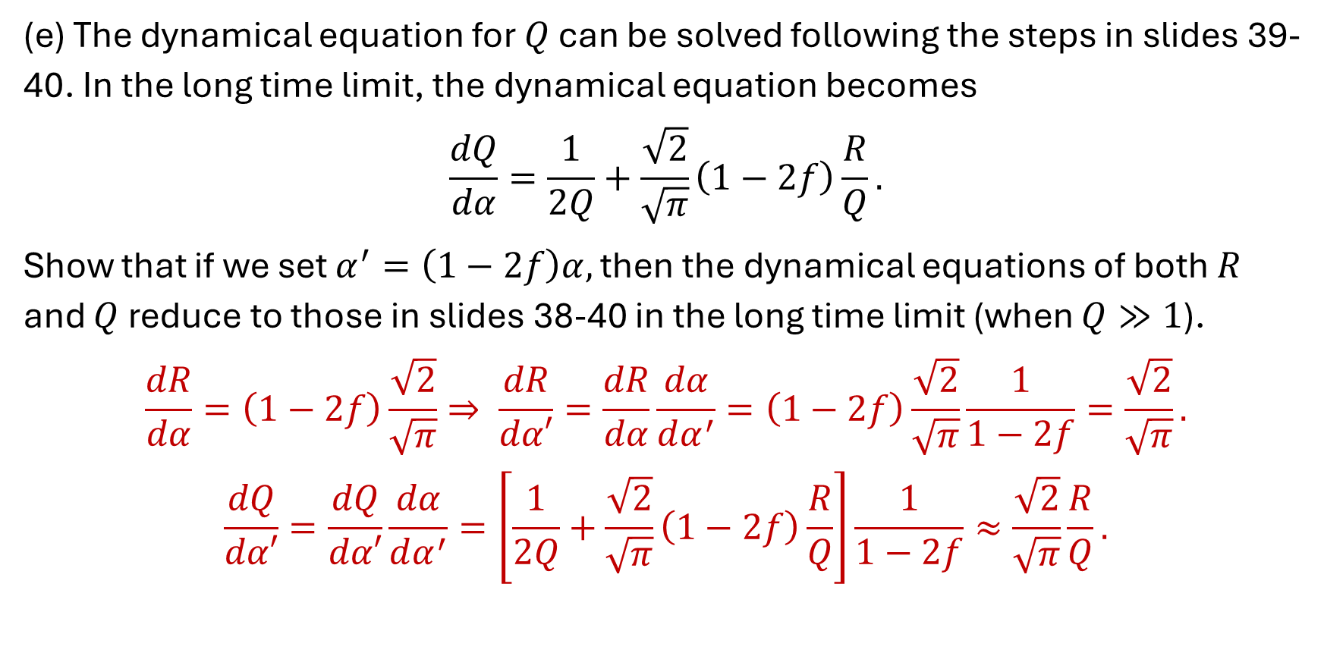
Noisy Dynamical Equation
(e) The dynamical equation for $Q$ can be solved following the steps in slides 39-40. In the long time limit, the dynamical equation becomes
$$\frac{dQ}{dα}=\frac{1}{2Q}+\frac{\sqrt{2}}{\sqrt{π}}\left(1−2f\right)\frac{R}{Q}.$$
Show that if we set $α^{′}=\left(1−2f\right)α,$ then the dynamical equations of both $R$ and $Q$ reduce to those in slides 38-40 in the long time limit (when $Q≫1$).
$$\frac{dR}{dα}=\left(1−2f\right)\frac{\sqrt{2}}{\sqrt{π}}⇒ \frac{dR}{dα′}=\frac{dR}{dα}\frac{dα}{dα^{′}}=\left(1−2f\right)\frac{\sqrt{2}}{\sqrt{π}}\frac{1}{1−2f}=\frac{\sqrt{2}}{\sqrt{π}}.$$
$$\frac{dQ}{dα′}=\frac{dQ}{dα′}\frac{dα}{dα^{′}}=\left[\frac{1}{2Q}+\frac{\sqrt{2}}{\sqrt{π}}\left(1−2f\right)\frac{R}{Q}\right]\frac{1}{1−2f}≈\frac{\sqrt{2}}{\sqrt{π}}\frac{R}{Q}.$$

Slide 10
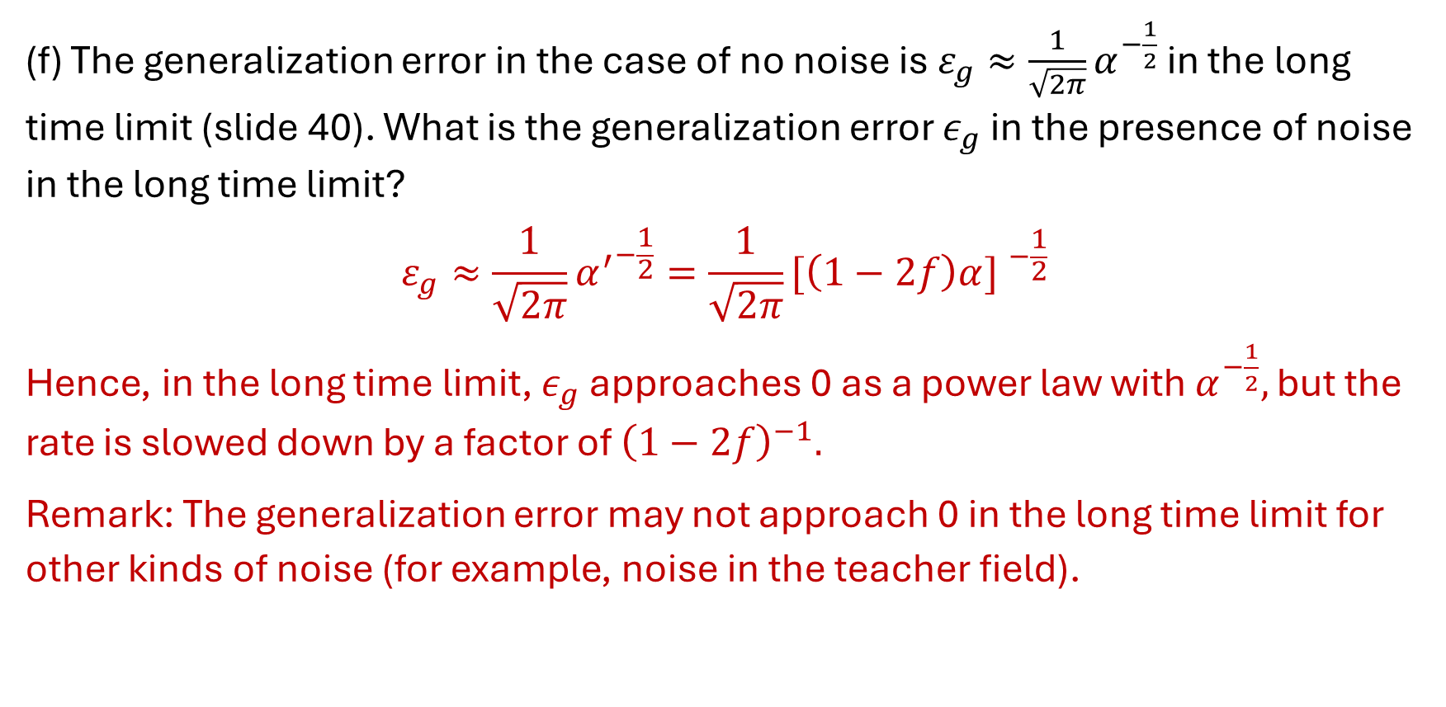
Noisy Generalization Error
(f) The generalization error in the case of no noise is $ε_{g}≈\frac{1}{\sqrt{2π}}α^{−\frac{1}{2}}$ in the long time limit (slide 40). What is the generalization error $ε_{g}$ in the presence of noise in the long time limit?
$$ε_{g}≈\frac{1}{\sqrt{2π}}{α^{′}}^{−\frac{1}{2}}=\frac{1}{\sqrt{2π}}{[\left(1−2f\right)α] }^{−\frac{1}{2}}$$
Hence, in the long time limit, $ε_{g}$ approaches 0 as a power law with $α^{−\frac{1}{2}},$ but the rate is slowed down by a factor of ${\left(1−2f\right)}^{−1}.$
Remark: The generalization error may not approach 0 in the long time limit for other kinds of noise (for example, noise in the teacher field).

Slide 11
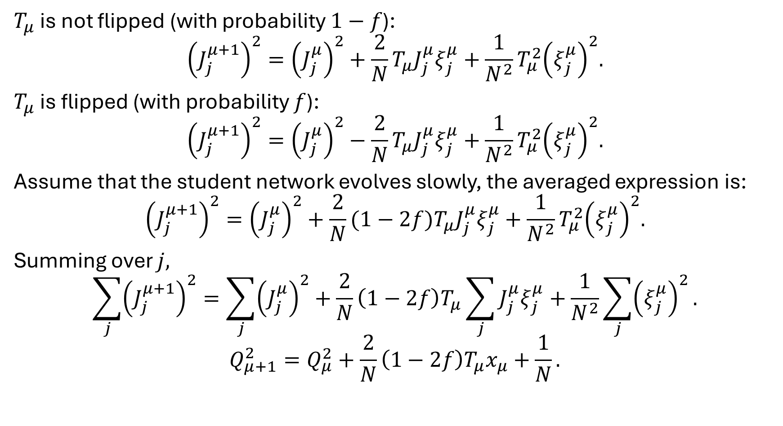

Dynamical Equation of $Q$
$T_{μ}$ is not flipped (with probability $1−f$):
$${\left(J_{j}^{μ+1}\right)}^{2}={\left(J_{j}^{μ}\right)}^{2}+\frac{2}{N}T_{μ}J_{j}^{μ}ξ_{j}^{μ}+\frac{1}{N^{2}}T_{μ}^{2}{\left(ξ_{j}^{μ}\right)}^{2}.$$
$T_{μ}$ is flipped (with probability $f$):
$${\left(J_{j}^{μ+1}\right)}^{2}={\left(J_{j}^{μ}\right)}^{2}−\frac{2}{N}T_{μ}J_{j}^{μ}ξ_{j}^{μ}+\frac{1}{N^{2}}T_{μ}^{2}{\left(ξ_{j}^{μ}\right)}^{2}.$$
Assume that the student network evolves slowly, the averaged expression is:
$${\left(J_{j}^{μ+1}\right)}^{2}={\left(J_{j}^{μ}\right)}^{2}+\frac{2}{N}(1−2f)T_{μ}J_{j}^{μ}ξ_{j}^{μ}+\frac{1}{N^{2}}T_{μ}^{2}{\left(ξ_{j}^{μ}\right)}^{2}.$$
Summing over $j,$
$$\sum_{j}{{\left(J_{j}^{μ+1}\right)}^{2}}=\sum_{j}{{\left(J_{j}^{μ}\right)}^{2}}+\frac{2}{N}\left(1−2f\right)T_{μ}\sum_{j}{J_{j}^{μ}ξ_{j}^{μ}}+\frac{1}{N^{2}}\sum_{j}{{\left(ξ_{j}^{μ}\right)}^{2}}.$$
$$Q_{μ+1}^{2}=Q_{μ}^{2}+\frac{2}{N}\left(1−2f\right)T_{μ}x_{μ}+\frac{1}{N}.$$

Slide 12
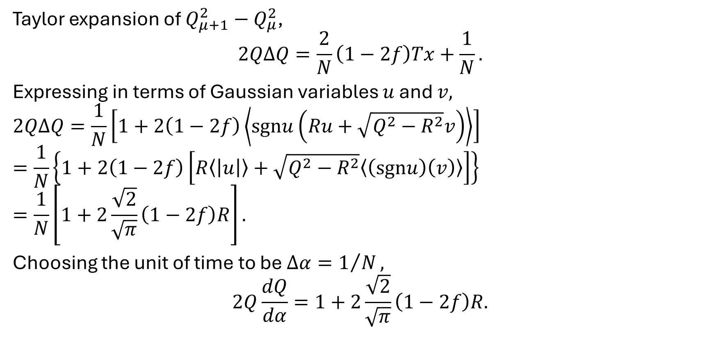
Taylor expansion of $Q_{μ+1}^{2}−Q_{μ}^{2}$,
$$2QΔQ=\frac{2}{N}\left(1−2f\right)Tx+\frac{1}{N}.$$
Expressing in terms of Gaussian variables $u$ and $v,$
$$2QΔQ=\frac{1}{N}\left[1+2\left(1−2f\right)\left\langle sgnu\left(Ru+\sqrt{Q^{2}−R^{2}}v\right)\right\rangle \right]$$
$$=\frac{1}{N}\left\{1+2\left(1−2f\right)\left[R\left\langle \left|u\right|\right\rangle +\sqrt{Q^{2}−R^{2}}\left\langle \left(sgnu\right)\left(v\right)\right\rangle \right]\right\}$$
$$=\frac{1}{N}\left[1+2\frac{\sqrt{2}}{\sqrt{π}}\left(1−2f\right)R\right].$$
Choosing the unit of time to be $Δα=1/N,$
$$2Q\frac{dQ}{dα}=1+2\frac{\sqrt{2}}{\sqrt{π}}\left(1−2f\right)R.$$

